Slide 1
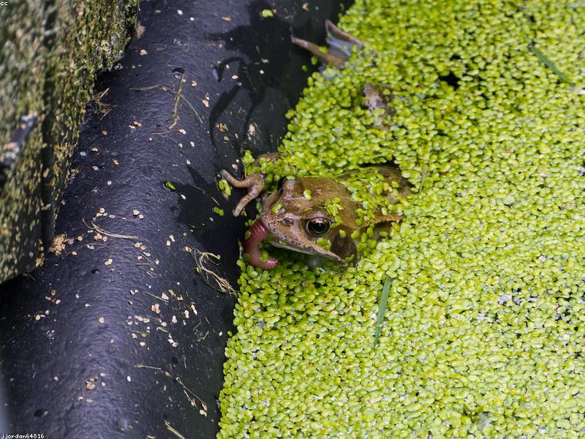
Introduction to Duckweed
- Overview of duckweed as a plant group
- Importance in ecosystems
- Common habitats
- Nutritional value
- Uses in aquaculture

Slide 2

Lemna Minor
- Description and characteristics
- Growth patterns
- Environmental benefits
- Uses in wastewater treatment
- Distribution

Slide 3
Spirodela Polyrhiza
- Unique features of Spirodela
- Size and shape
- Role in aquatic ecosystems
- Potential for biofuel production
- Research studies

Slide 4
Wolffia Arrhiza
- Smallest flowering plant
- Growth and reproduction
- Nutritional benefits
- Applications in food industry
- Conservation status

Slide 5
Conclusion
- Summary of duckweed types
- Importance of biodiversity
- Future research directions
- Potential for sustainable agriculture
- Call to action for conservation efforts

